Slide 1
Risk management

Slide 2
RISK MANAGEMEnT
Risk Management is the system of identifying addressing and eliminating these problems before they can damage the project.
Various activities that are carried out for risk management are:
Risk Identification
Risk Projection
Risk Refinement
Risk Mitigation, Monitoring & Management

Slide 3
SOFTWARE RISKS
There are two characteristics of the risks are
Uncertainty of the risks.
When risks occur, unwanted consequences or losses will occur.

Slide 4
TYPES OF RISKS
Project Risk
Technical Risk
Business Risk
- Market, Strategic, Sales, Management & Budget Risks
Known Risk
- Predictable Risk
- Unpredictable Risk

Slide 5
RISK MANAGEMENT
Reactive Risk Strategy
- Older approach of risk management
- When project gets into trouble then only corrective action is taken.
- If the risks do not get managed then project is in danger .
- In this strategy no preventive care is taken
Proactive Risk Strategy
- Begins before the technical activity by considering the probable risk.
- In this strategy potential risks are identified first then their probability & impact is analyzed. Such risks are then specified according to their priorities

Slide 6
RISK IDENTIFICATION
Efforts taken to specify threats to the project plan
Two approaches:
Generic Risk Identification – potential threat identification to software project.
Product-Specific Risk Identification – product specific threat identification by understanding people, technology & working environment in which the product gets built.
Normally the risk identification is done by the project manager

Slide 7
Preparation of risk item check list
The risk items can be identified using following known & predictable
components,
Product Size
Business Impact
Customer characteristics
Development Environment
Staff Size & Experience
Technology to be built
After preparing a risk item checklist a questionnaire is prepared. These set of questions should be answered & based on these answers the impact or seriousness of particular risk item can be judged.

Slide 8
Risk Projection
Also called as Risk Estimation.
Steps for risk projection
Establish a scale that indicates the probability of risk being real
Enlist the consequences of the risk
Estimate the impact of the risk on the project & product
Maintain the overall accuracy of the risk projection in order to have clear understanding of the software that is to be built.
These steps helps to prioritize the risks. Once the risks are prioritized then it becomes easy to allocate the resources for handling them.

Slide 9
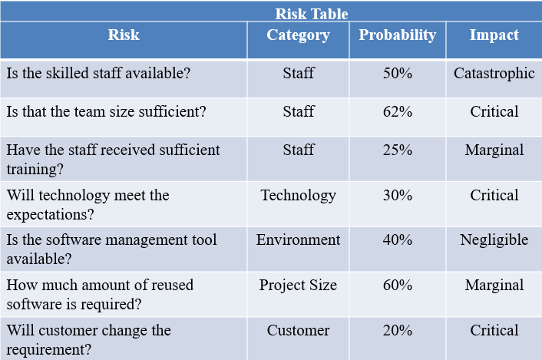
Building Risk Table Building the risk table is the simplest & most commonly used technique adopted by project managers in order to project the risks. The sample risk table

Slide 10
RISK EXPOSURE
The risk exposure can be calculated by following formula:
Risk Exposure = Probability of occurrence of risk x Cost
Eg: Consider a software project with 77 percent of risk probability in which 15 components were developed from the scratch. Each component have on an average 500 LOC & each LOC have an average cost of $10. Then the risk exposure can be calculated as,
Cost = Number of components * LOC * cost of each LOC
= 15 * 500 * 10 = $75000
Risk Exposure = Probability of occurrence of risk x cost
= 77 / 100 * 75000
= $57750
Thus risk exposure for each risk from risk table is calculated. The total risk exposure of all risks helps in determining the final cost of the project.

Slide 11
RISK REFINEMENT
It is a process of specifying the risk in more detail. The risk refinement can be represented using CTC format suggested by D.P.Gluch.
The CTC stands for condition-Transition-consequence. The condition is first stated & then based on this condition sub conditions can be derived.
This approach makes it easier for the project manager to analyze the risk in greater detail.

Slide 12
RMMM
RMMM stands for risk Mitigation, Monitoring & Management. Three issues in strategy for handling the risk is
Risk Avoidance (or) Mitigation
Risk Monitoring
Risk Management

Slide 13
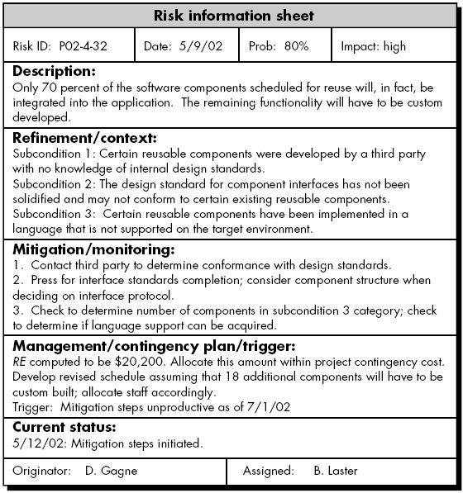
RMMM PLAN
A document in which all the risk analysis activities are described.

Slide 14
Slide Tite
Thank You!

